Slide 1


Data Analytics Consulting Virtual Internship
Get ready for a unique virtual internship experience where you'll learn the essential skills and tools needed to become a successful data analyst.
vK
by Vishnu Kumar D S

Slide 2

Introduction to the Virtual Internship
1
Get Hands-On Experience 🤝
2
Collaborate with Experts 🧑‍🤝‍🧑
3
Sharpen Your Skills 📈
Learn and apply practical skills in a virtual environment to prepare you for real-world challenges.
Work alongside seasoned professionals to gain insight and knowledge while working on real-world projects.
Develop key technical and analytical competencies designed to help you succeed in the competitive field of data analytics consulting.

Slide 3
Objectives of the Internship
Apply Analytics Techniques 🛠
Gain experience in some of the latest and most effective analytics tools and techniques, and learn how they are applied in business scenarios.
1
2
3
Enhance Your Analytics Knowledge 🧠
Build Your Business Acumen 💼
Understand best practices in data analytics consulting, including how to problem-solve, communicate effectively, and project manage.
Learn the ins and outs of data analysis, all while enhancing and sharpening your technical knowledge and skills.

Slide 4
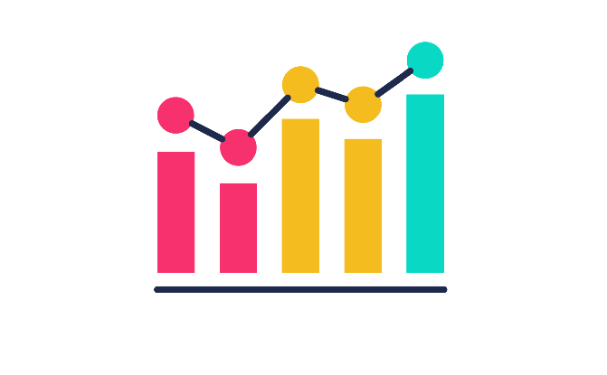
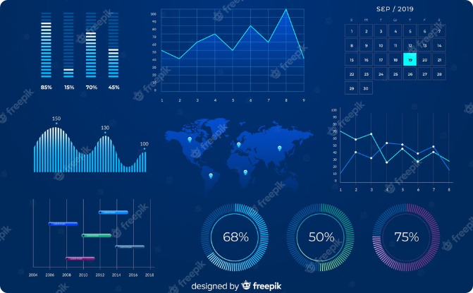
Overview of Data Analytics Consulting
What is Data Analytics Consulting?
Key Statistical Concepts 📈
Explore the world of data analytics consulting and how it can help businesses make better, more informed decisions.
Learn the foundational statistical concepts and theories necessary for data analysis and interpretation.

Slide 5
Tools and Techniques for Data Analysis
Data Management and Cleaning 🧹
Data Visualization and Storytelling 📊
Discover best practices and techniques for cleaning, validating, and analyzing data from various sources and formats.
Learn how to use graphical representations to help stakeholders better understand complex business problems and opportunities.
Predictive Modeling and Machine Learning 🔮
Data Ethics and Governance 🤝
Understand the importance of ethics and governance in data analytics consulting, and how to ensure that your analyses are compliant and transparent.
Explore the emerging field of predictive modeling and how it's changing the way businesses make decisions.

Slide 6
Hands-On Experience in Data Analysis
1
Introduction to the Tools 🪚
Explore data analysis tools like SQL, Excel, and Python, with a focus on giving you the skills you need to tackle complex analytical challenges.
Real-World Business Scenarios 📈
2
Gain experience working hands-on with real datasets and scenarios, helping you to build your analytical skills and knowledge base.
3
Collaborative Team Projects 👥
Work with a team to complete a comprehensive business analysis project, honing your collaboration and project management skills.

Slide 7
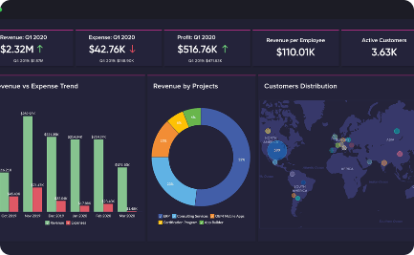
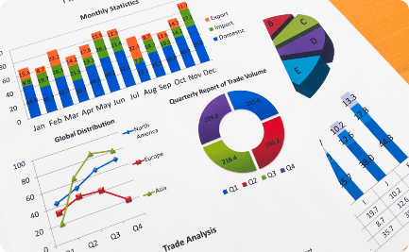

Practical Applications of Data Analytics Consulting
Marketing and Customer Analytics 🎯
Financial Analytics 💰
Beyond Business 🚀
Learn how data analytics can help you gain insights into financial models, ROI, and risk analysis, allowing you to make better business decisions.
Discover how data analytics is being used in other sectors, and how it's enabling businesses to innovate by uncovering new insights and opportunities.
Explore data analytics use cases in marketing, from customer segmentation and targeting to measuring marketing performance and ROI.

Slide 8

Conclusion and Next Steps in the Data Analytics Field
Take your next steps toward becoming a successful data analytics consultant. Connect with professionals in the field, enrolling in further courses and certifications, build real-world projects, and applying your new, valuable knowledge in the field.

